Slide 1
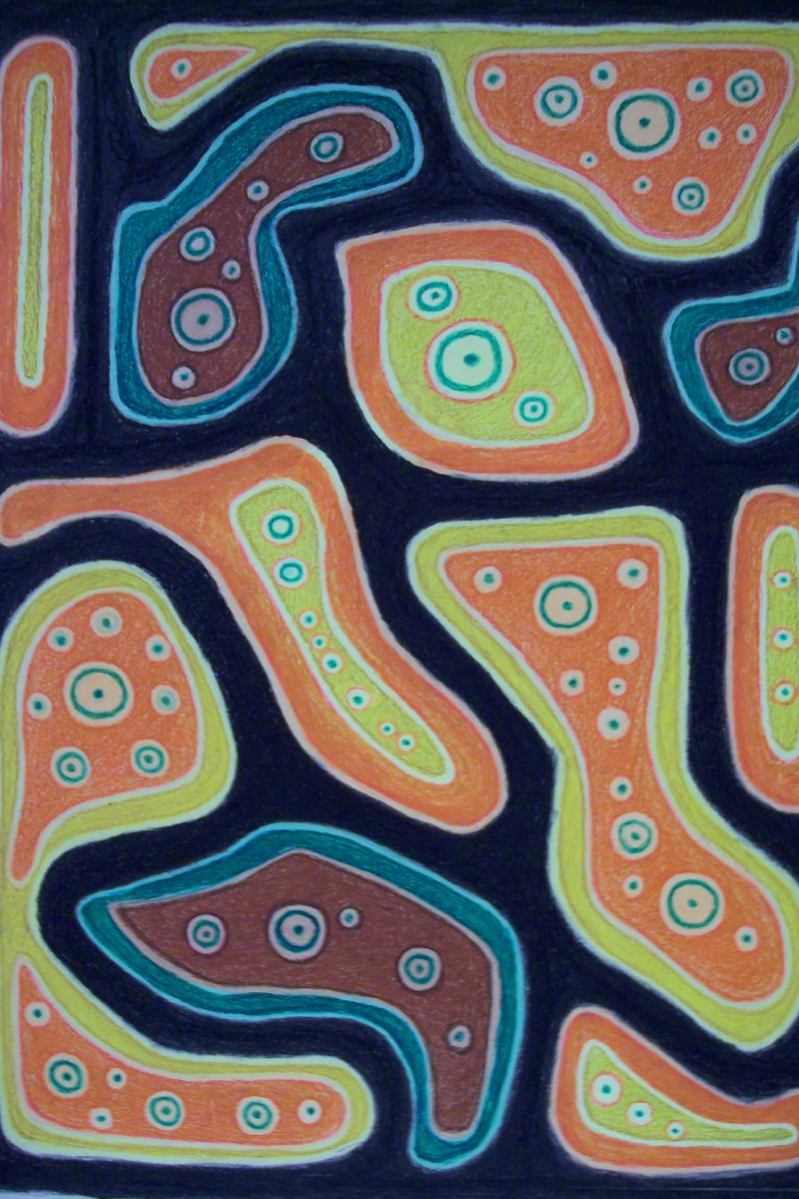
Permanent Collection Lesson Plan
Visual Arts and Science
with Charles St. Julien’s Cancer
By Rani Hebert
VIAR 216: Art in Education, Fall 2020
Professor: Dr. Claire Schultz
University of Louisiana at Lafayette

Slide 2
Brief Overview
In this lesson, students will create their own unique cell/cells based on the knowledge they have gained about cells during previous science lessons. The cells they create will also in some form represent themselves. Students’ cells do not have to be real or “anatomically correct.” This activity is more about being creative and showing a little bit about themselves, or as a pun, “themCELLs.” The purpose of this lesson is to encourage students to think creatively, find out what makes them them, and see that art and science are not distant from one another. This lesson was inspired by Charles W. St. Julien’s work Cancer. The work is abstract and looks like a fun funky version of cells you might see under a microscope. This is where the idea for students to make unique versions of their own cells came from.

Slide 3
Grade Level (Range): 3-5
Integration Content Areas: This plan is directly connected with the sciences, specifically biology, and visual art.
Objectives:
•Science: Students will be able to take the understanding of cells as the building blocks of who we are physically and use this to create their own type of cell using the same understanding that the things we love and what “defines” us make up who we are in the non-physical sense.
•Visual Arts: Students will use their imagination to create a new type of cell to express themselves with the use of shape, texture, and color by using various dry media such as pencil, crayon, markers, and other non-conventional items such as buttons, pipe cleaners, sequins, etc. if they so choose.

Slide 4
Big Ideas/Essential Questions
This activity will encourage and allow students to express who they are and their identity as individuals.
Students should ask themselves “What makes me, me, and how can I use this activity to express that?”
Students should also come to an understanding that we are all unique and the things that make up the little parts of us such as a cell, have an impact on who we are as a whole. “How do the little things in my life make up who I am as a person?” “What kind of functions do the things I fill my life with serve?”

Slide 5
Art Definitions
•Shapes: 2-dimensional organic or geometric merging lines
•Color: hue, value, and intensity
•Texture: feeling or appearance of a surface
•Media: material or tools used by an artist.
•Crayons, paint, pencils, markers, etc.

Slide 6
National Art Standards Domains
•Create- Students will create their own cells that reflect who they are as individuals through abstract expressionism by exploring color, texture, and shape.
•Connect- The students will make connections between biological cells as something that make up our bodies and the things in their life such as personality, hobbies, interests, and other things that make up who they are as a person. These two things will be connected to create their own unique cell.
•Respond- This lesson encourages students to be attentive to their own lives and what it is filled with. In order to complete the activity, they will have to analyze and interpret what is it that make them who they are.
•Present- Students will present their artwork at the end of the lesson in order to express and explain why they chose to use the elements in the ways that they did and how it relates back to who they are as an individual

Slide 7
Charles St. Julien (American, 1925 -1987)
Cancer, no date
Wax crayon on illustration board with varnish coating
H-40 W-30 inches
Louisiana Collection
Gift of Mark Bercier
1990.01.09

Slide 8
Historical Context/Connections
Charles St. Julien was born in 1925 and resided in Lafayette, Louisiana. He studied art at the Philadelphia Museum of Art in his youth.
His work went relatively unnoticed until it was exhibited at the Zigler Museum in Jennings, Louisiana and seen by artist Mark Bercier who befriended him.
After his death in 1987, the contents of St. Julien's studio were left to Bercier. The Lafayette Arts Alliance paid tribute to the artist with an exhibition titled Mixed Blessings in 1988 at the Old Lafayette Hardware Store.
St. Julien's work can be found in the collection of the Ohr-O'Keefe Museum of Art in Biloxi, Mississippi.

Slide 9
Concepts and Media
Two big elements in this art activity are color and shape.
Students should look at how they use color to describe themselves and what they feel the colors they use says about them.
The shapes they use in their cells should also give way to a greater meaning that they define in connection with their own lives.
The media in this lesson is encouraged to be explored greatly and for students to use media outside of the norm. This relates back to each work being unique as each individual is unique.

Slide 10
Materials List
•Construction paper (multicolored for students to choose and also layer)
•Dry Media (Pencils, crayons, markers) this is up for student exploration
•Unconventional multi-media for students to choose from (buttons, sequins, pipe cleaners) things that can explore texture and again allow for students to make connections with.
•Glue
•Scissors

Slide 11
Day 1
(This lesson would follow a lesson on cells)
•Review cells by comparing and contrasting different types of cells.
•Express how the uniqueness of each cell is important because of the role it plays.
•Ask students what kind of role they think they play in the world. Relate this back to the notion that each person is as unique as the different cells.
•Introduce the activity to the students.
•Allow time for brainstorming: What type of cell? Does this cell represent one main part of who you are or does the cell represent you as a whole? What kind of colors and shapes could be used to express these ideas?
•Brainstorm what media they would like to use and what some of the textured media they use will represent to them.

Slide 12
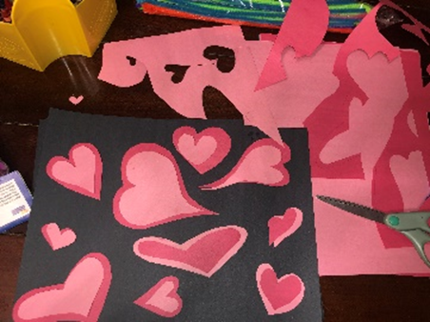
Day 2
•Students will begin creating their art projects once they have a solid idea of what about themselves, they want to incorporate into their project.
•Students should start by cutting out all shapes they would like to use from the construction paper. Different sizes of the same shape can be used for layering.

Slide 13
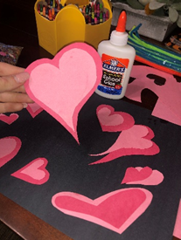
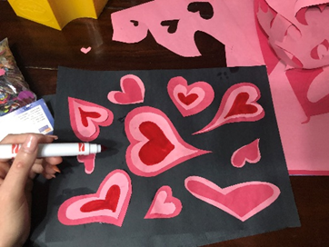
Day 2 Continued
•I found the most efficient method was to glue the layered pieces together first, figure out what placement you want, and then glue the shapes down to the background sheet.
•I used marker to create additional layering which can save time versus cutting the shapes out.

Slide 14
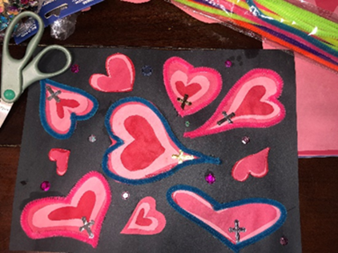
Day 3
•Students will continue with and finish their projects.
•Students can choose from various media to create texture in their art.
•Add in other elements chosen by students that mean something to who they are.

Slide 15
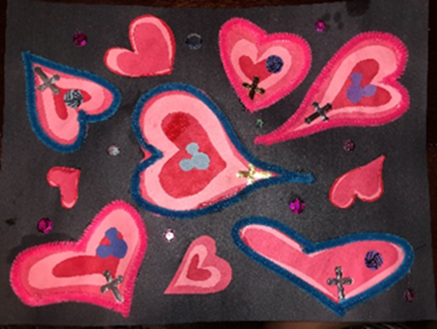
Day 4
•Students will present their final works of art to the class.
•They should discuss what kind of cell they have made, what it represents, and why they chose certain shapes, colors and textures in regards to what they wanted the art to say about themselves.

Slide 16
Assessment and Rubric
Objective | Exceeds | Meets | Does not meet
Student’s work is unique and shows individuality. It is clear through their elements what they are trying to say.
Student demonstrates color being used as emotion to further the identity they want to show.
Students art displays shape, texture, and multi colors.
Student uses understanding of biological cells to create their own unique cells with parts that work together to support the entire idea of what they are trying to portray.
Presentation and explanation of art supports the student’s work, and helps the class come to a better understanding of who the student is.

